Slide 1
4
INTEGRALS

Slide 2
4.1
Areas and Distances

Slide 3
INTEGRALS
In Chapter 2, we used the tangent and velocity problems to introduce the derivative—the central idea in differential calculus.
In much the same way, this chapter starts with the area and distance problems and uses them to formulate the idea of a definite integral—the basic concept of integral calculus.

Slide 4
INTEGRALS
In Chapters 7, we will see how to use the integral to solve problems concerning:
Volumes
Lengths of curves
Population predictions
Cardiac output
Forces on a dam
Work
Consumer surplus
Baseball

Slide 5
INTEGRALS
There is a connection between integral calculus and differential calculus.
The Fundamental Theorem of Calculus (FTC) relates the integral to the derivative.
We will see in this chapter that it greatly simplifies the solution of many problems.

Slide 6
The Area Problem

Slide 7
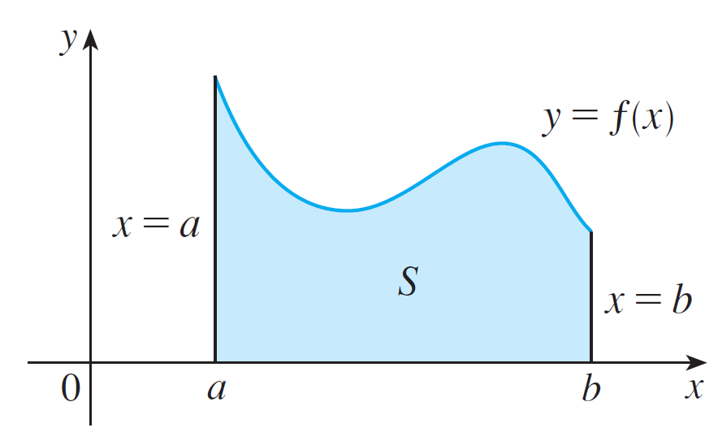
The Area Problem
We begin by attempting to solve the area problem: Find the area of the region S that lies under the curve y = f (x) from a to b.
This means that S, illustrated in Figure 1, is bounded by the graph of a continuous function f [where f (x) ≥ 0], the vertical lines x = a and x = b, and the x-axis.
Figure 1

Slide 8
AREA PROBLEM
In trying to solve the area problem, we have to ask ourselves:
What is the meaning of the word area?
The question is easy to answer for regions with straight sides.

Slide 9

RECTANGLES
For a rectangle, the area is defined as:
The product of the length and the width.

Slide 10
TRIANGLES
The area of a triangle is:
Half the base times the height.

Slide 11
POLYGONS
The area of a polygon is found by:
Dividing it into triangles and adding the areas of the triangles.

Slide 12
The Area Problem
However, it isn’t so easy to find the area of a region with curved sides.
We all have an intuitive idea of what the area of a region is. But part of the area problem is to make this intuitive idea precise by giving an exact definition of area.
We first approximate the region S by rectangles and then we take the limit of the areas of these rectangles as we increase the number of rectangles.
The next example illustrates the procedure.

Slide 13
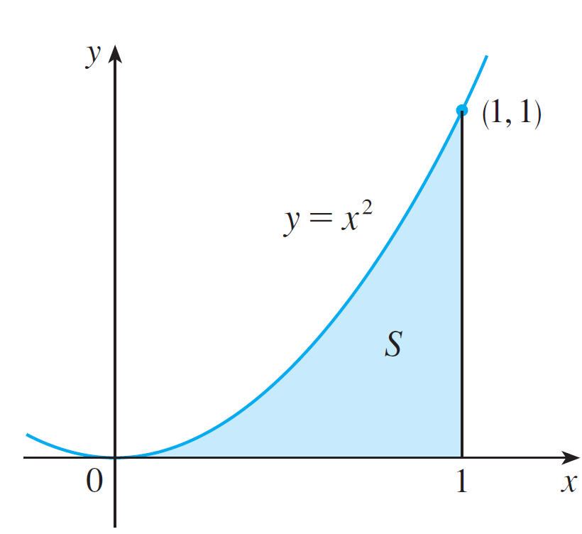
Example 1
Use rectangles to estimate the area under the parabola y = x² from 0 to 1 (the parabolic region S illustrated in Figure 3).
Figure 3

Slide 14
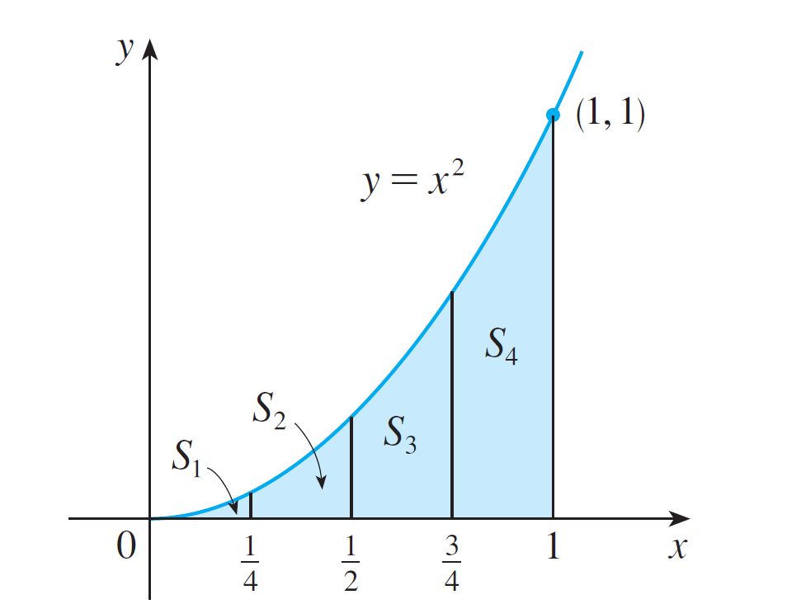



Example 1- Solution
SOLUTION:
We first notice that the area of S must be somewhere between 0 and 1 because S is contained in a square with side length 1, but we can certainly do better than that.
Suppose we divide S into
four strips S₁, S₂, S₃, and S₄
by drawing the vertical lines
, , and as in
Figure 4(a).
Figure 4(a)

Slide 15
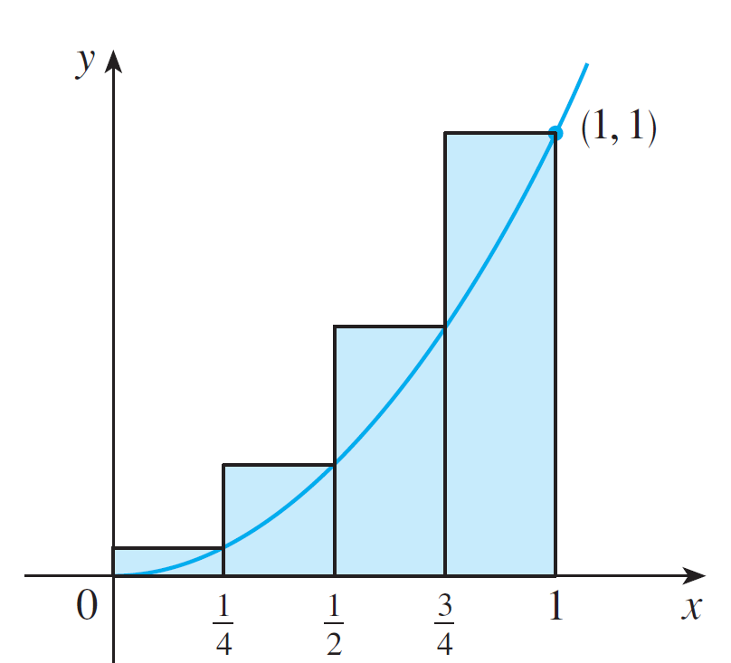
Example 1 – Solution
cont’d
We can approximate each strip by a rectangle whose base is the same as the strip and whose height is the same as the right edge of the strip [see Figure 4(b)].
Figure 4(b)

Slide 16






Example 1 – Solution
cont’d
In other words, the heights of these rectangles are the values of the function f (x) = x² at the right endpoints of the
subintervals , , , and .
Each rectangle has width and the heights are and 1².
If we let R₄ be the sum of the areas of these approximating rectangles, we get

Slide 17

Example 1 – Solution
cont’d
From Figure 4(b) we see that the area A of S is less than R₄, so
Figure 4(b)

Slide 18
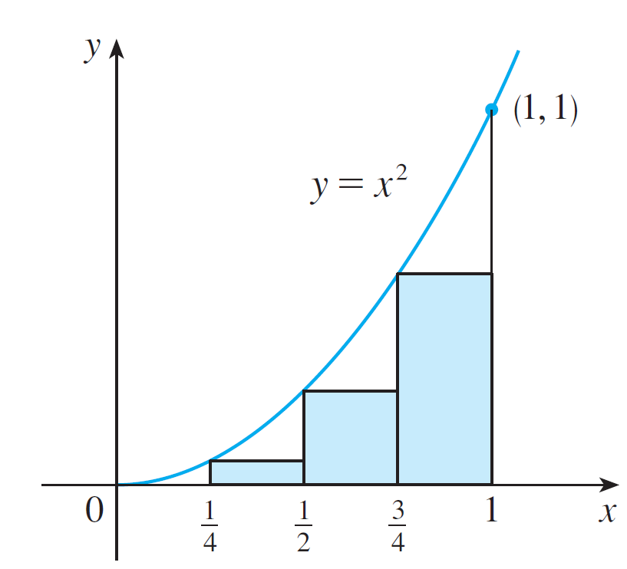
Example 1 – Solution
cont’d
Instead of using the rectangles in Figure 4(b) we could use the smaller rectangles in Figure 5 whose heights are the values of f at the left endpoints of the subintervals.
(The leftmost rectangle has collapsed because its height is 0.)
Figure 5

Slide 19
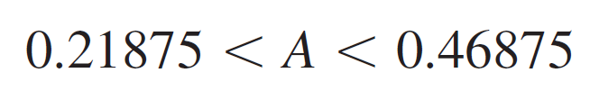
Example 1 – Solution
cont’d
The sum of the areas of these approximating rectangles is
We see that the area of S is larger than L₄, so we have lower and upper estimates for A:
We can repeat this procedure with a larger number of strips.

Slide 20
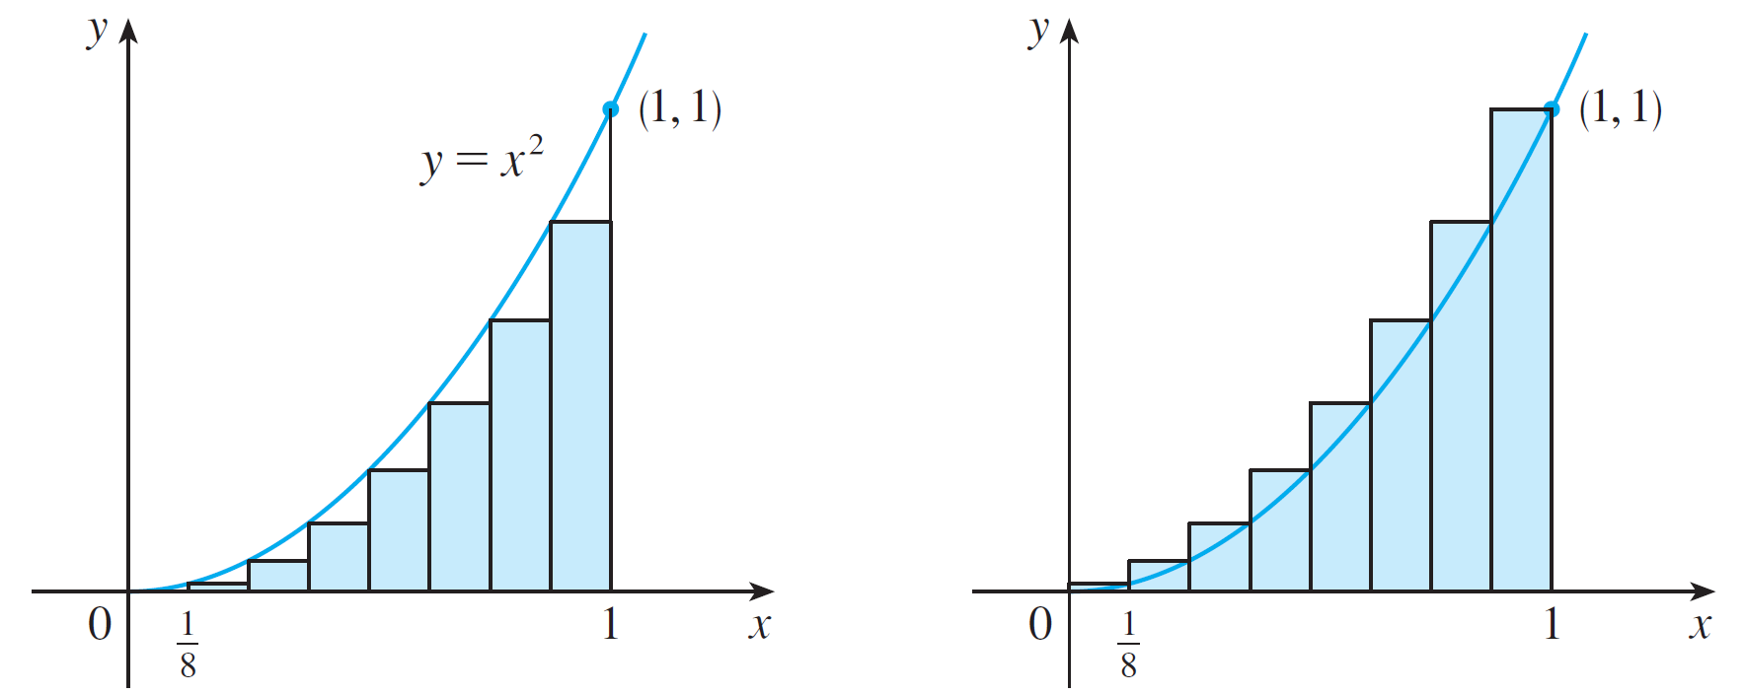
Example 1 – Solution
cont’d
Figure 6 shows what happens when we divide the region S into eight strips of equal width.
(a) Using left endpoints
(b) Using right endpoints
Approximating S with eight rectangles
Figure 6

Slide 21
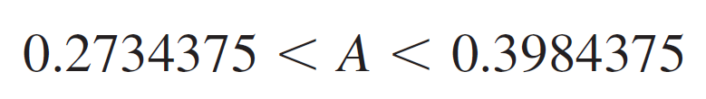
Example 1 – Solution
cont’d
By computing the sum of the areas of the smaller rectangles (L₈) and the sum of the areas of the larger rectangles (R₈), we obtain better lower and upper estimates for A:
So one possible answer to the question is to say that the true area of S lies somewhere between 0.2734375 and 0.3984375.
We could obtain better estimates by increasing the number of strips.

Slide 22
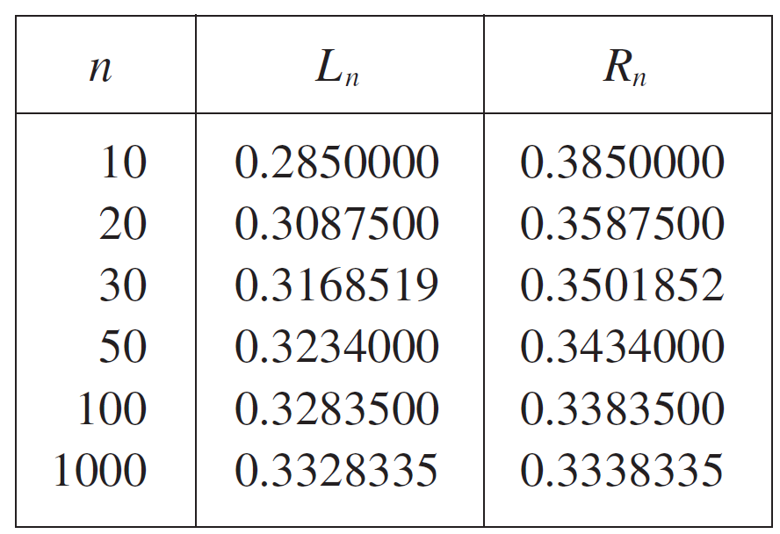
Example 1 – Solution
cont’d
The following table shows the results of similar calculations (with a computer) using n rectangles whose heights are found with left endpoints (L_{n}) or right endpoints (R_{n}).

Slide 23
Example 1 – Solution
cont’d
In particular, we see by using 50 strips that the area lies between 0.3234 and 0.3434.
With 1000 strips we narrow it down even more:
A lies between 0.3328335 and 0.3338335.
A good estimate is obtained by averaging these numbers:
A ≈ 0.3333335.

Slide 24
Example 2
For the region S in Example 1, show that the sum of the areas of the upper approximating rectangles approaches 1/3, that is,

Slide 25
Example 2 SOLUTION
R_{n} is the sum of the areas of the n rectangles.
Each rectangle has width 1/n and the heights are the values of the function f(x) = x² at the points 1/n, 2/n, 3/n, …, n/n.
That is, the heights are (1/n)², (2/n)², (3/n)², …, (n/n)².

Slide 26
Example 2 SOLUTION
Thus,

Slide 27
Example 2 SOLUTION
Here, we need the formula for the sum of the squares of the first n positive integers:
Perhaps you have seen this formula before.
It is proved in Example 5 in Appendix E.
Putting Formula 1 into our expression for R_{n}, we get:

Slide 28
Example 2 SOLUTION
So, we have:

Slide 29
AREA PROBLEM
It can be shown that the lower approximating sums also approach 1/3, that is,

Slide 30
AREA PROBLEM
From Figure 8 , it appears that, as n increases, R_{n} becomes a better and better approximation to the area of S.

Slide 31
AREA PROBLEM
From Figure 9, it appears that, as n increases, L_{n} becomes a better and better approximations to the area of S.

Slide 32
AREA PROBLEM
Thus, we define the area A to be the limit of the sums of the areas of the approximating rectangles, that is,

Slide 33
The Area Problem
We can find the more general region S of Figure 1.
Figure 1

Slide 34
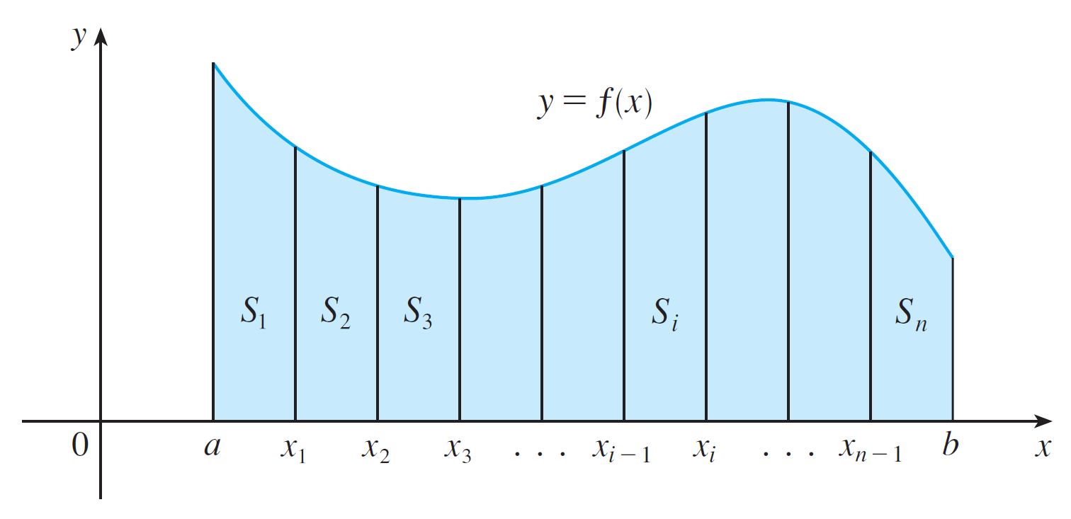
The Area Problem
We start by subdividing S into n strips S₁, S₂, …, S_{n} of equal width as in Figure 10.
Figure 10

Slide 35
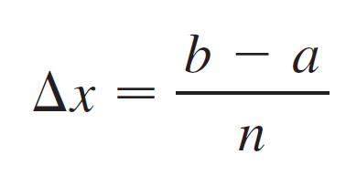
The Area Problem
The width of the interval [a, b] is b – a, so the width of each of the n strips is
These strips divide the interval [a, b] into n subintervals
where x₀ = a and x_{n} = b.

Slide 36
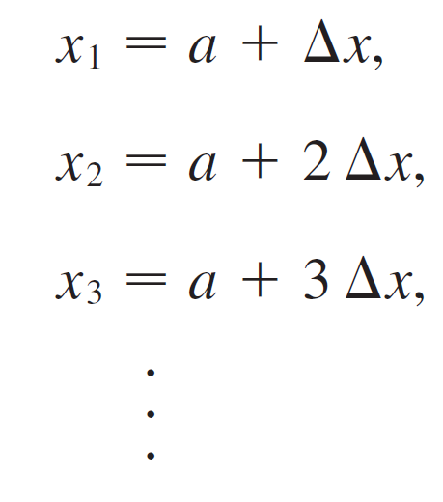
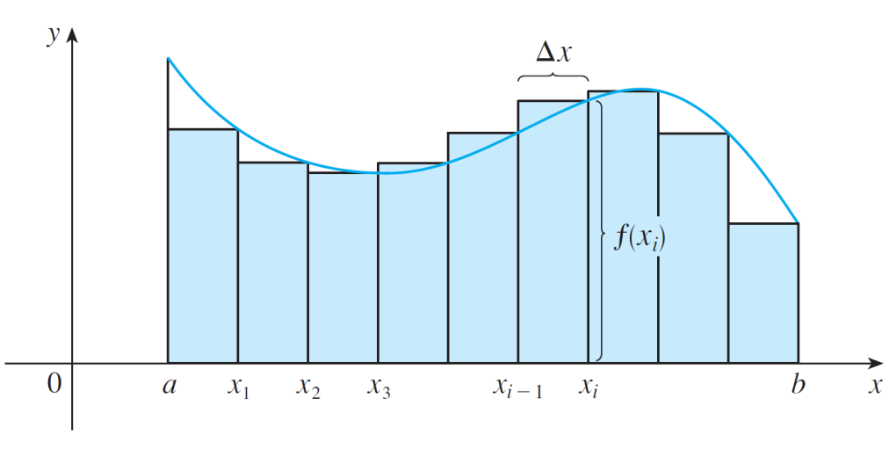
The Area Problem
The right endpoints of the subintervals are
Let’s approximate the i th strip S_{i} by a rectangle with width Δx and height f(x_{i}), which is the value of f at the right endpoint (see Figure 11).
Figure 11

Slide 37

The Area Problem
Then the area of the i th rectangle is f(x_{i}) x. What we think of intuitively as the area of S is approximated by the sum of the areas of these rectangles, which is

Slide 38
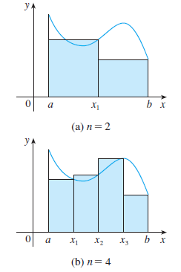
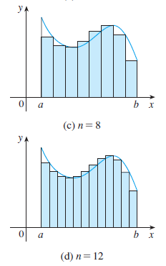
The Area Problem
Figure 12 shows this approximation for n = 2,4,6,8, and 12. Notice that this approximation appears to become better and better as the number of strips increases, that is as
Figure 12

Slide 39
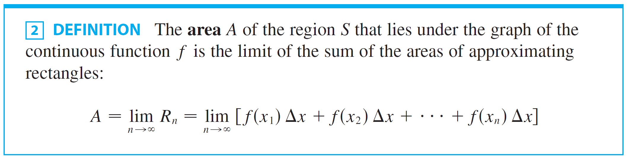
The Area Problem
Therefore we define the area A of the region S in the following way.
It can be proved that the limit in Definition 2 always exists, since we are assuming that f is continuous. It can also be shown that we get the same value if we use left endpoints:

Slide 40



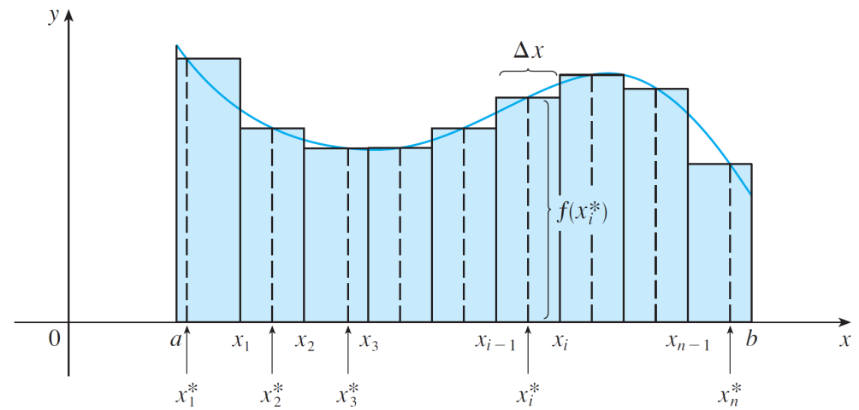
The Area Problem
In fact, instead of using left endpoints or right endpoints, we could take the height of the i th rectangle to be the value of f at any number in the i th subinterval .
We call the numbers the sample points.
Figure 13 shows approximating rectangles when the sample points are not chosen to be endpoints.
Figure 13

Slide 41

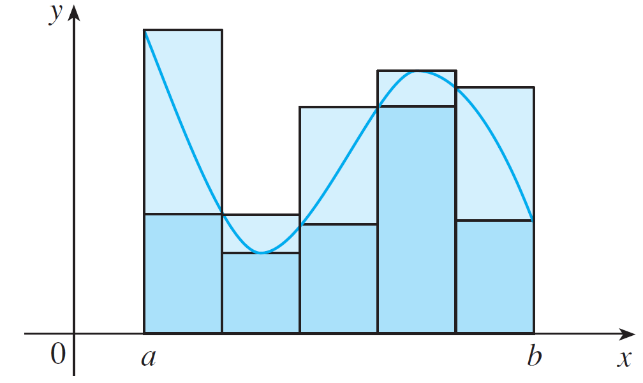
The Area Problem
So a more general expression for the area of S is
In general, we form lower (and upper) sums by choosing the sample points so that is the minimum (and maximum) value of f on the i th subinterval. (See Figure 14)
Lower sums (short rectangles) and upper sums (tall rectangles)
Figure 14

Slide 42
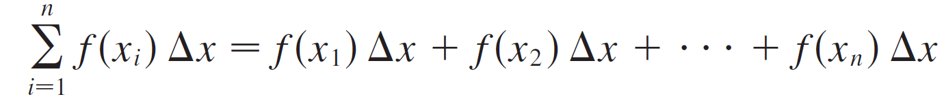
The Area Problem
We often use sigma notation to write sums with many terms more compactly.
For instance,

Slide 43
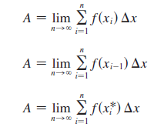

The Area Problem
So the expressions for area in Equations 2, 3, and 4 can be written as follows:
We can also rewrite Formula 1 in the following way:

Slide 44
Example 3
Let A be the area of the region that lies under the graph of f(x) = cos x between x = 0 and x = b, where 0 ≤ b ≤ π/2.
(a)Using right endpoints, find an expression for A as a limit. Do not evaluate the limit.
(b)Estimate the area for the case b = π /2 by taking the sample points to be midpoints and using four subintervals.

Slide 45
Example 3(a) SOLUTION
Since a = 0, the width of a subinterval is:
So, x₁ = b/n, x₂ = 2b/n, x₃ = 3b/n, x_{i} = ib/n, x_{n} = nb/n.
The sum of the areas of the approximating rectangles is:

Slide 46
Example 3(a) SOLUTION
According to Definition 2, the area is:
Using sigma notation, we could write:

Slide 47
Example 3(a) SOLUTION
It is difficult to evaluate this limit directly by hand.
However, with the aid of a computer algebra system (CAS), it isn’t hard.
In Section 5.3, we will be able to find A more easily using a different method.

Slide 48
Example 3(b) SOLUTION
With n = 4 and b = π/2, we have: ∆x = (π /2)/4 = π/8
So, the subintervals are: [0, π /8], [π /8, π /4], [π /4, 3 π /8], [3π /8, π /2]
The midpoints of these subintervals are: x₁* = π /16 x₂* = 3π /16 x₃* = 5π /16 x₄* = 7π /16

Slide 49
Example 3(b) SOLUTION
The sum of the areas of the four rectangles is:

Slide 50
Example 3(b) SOLUTION
So, an estimate for the area is: A ≈ 1.006

Slide 51
The Distance Problem

Slide 52

The Distance Problem
Now let’s consider the distance problem: Find the distance traveled by an object during a certain time period if the velocity of the object is known at all times.
If the velocity remains constant, then the distance problem is easy to solve by means of the formula
But if the velocity varies, it’s not so easy to find the distance traveled.
We investigate the problem in the next example.

Slide 53
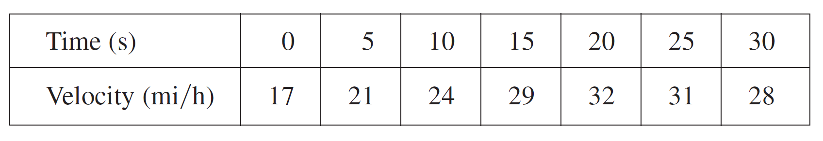
Example 4
Suppose the odometer on our car is broken and we want to estimate the distance driven over a 30-second time interval.
We take speedometer readings every five seconds and record them in the following table:

Slide 54
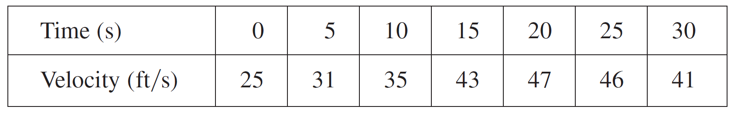
Example 4
cont’d
In order to have the time and the velocity in consistent units, let’s convert the velocity readings to feet per second (1 mi/h = 5280/3600 ft/s):
During the first five seconds the velocity doesn’t change very much, so we can estimate the distance traveled during that time by assuming that the velocity is constant.

Slide 55


Example 4
cont’d
If we take the velocity during that time interval to be the initial velocity (25 ft/s), then we obtain the approximate distance traveled during the first five seconds:
Similarly, during the second time interval the velocity is approximately constant and we take it to be the velocity when t = 5 s.
So our estimate for the distance traveled from t = 5 s to t = 10 s is

Slide 56
Example 4
cont’d
If we add similar estimates for the other time intervals, we obtain an estimate for the total distance traveled:
We could just as well have used the velocity at the end of each time period instead of the velocity at the beginning as our assumed constant velocity. Then our estimate becomes
If we had wanted a more accurate estimate, we could have taken velocity readings every two seconds, or even every second.

Slide 57
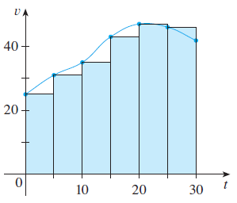
The Distance Problem
Perhaps the calculations in Example 4 remind you of the sums used earlier to estimate areas. The similarity is explained when we sketch a graph of the velocity function of the car in Figure 16 and draw rectangles whose heights are the initial velocities for each time interval.
Figure 16

Slide 58
The Distance Problem
The area of the first rectangle is 25 x 5 = 125, which is also our estimate for the distance traveled in the first five seconds.
In fact, the area of each rectangle can be interpreted as a distance because the height represents velocity and the width represents time. The sum of the
areas of the rectangles in Figure 16
is L₆= 1135, which is our initial estimate
for the total distance traveled.
Figure 16

Slide 59


The Distance Problem
In general, suppose an object moves with velocity v = f (t), where a ≤ t ≤ b and f (t) ≥ 0 (so the object always moves in the positive direction).
We take velocity readings at times so that the velocity is approximately constant on each subinterval.
If these times are equally spaced, then the time between consecutive readings is .

Slide 60
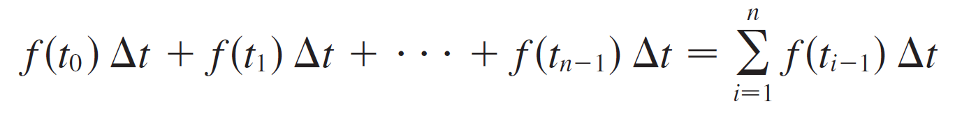
The Distance Problem
During the first time interval the velocity is approximately f (t₀) and so the distance traveled is approximately f (t₀) Δt.
Similarly, the distance traveled during the second time interval is about f (t₁) Δt and the total distance traveled during the time interval [a, b] is approximately

Slide 61
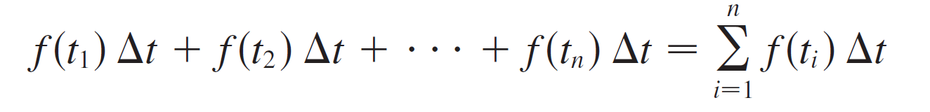
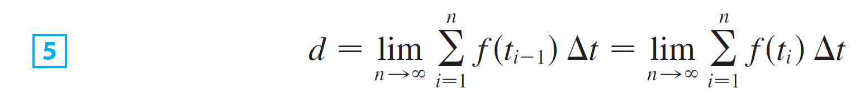
The Distance Problem
If we use the velocity at right endpoints instead of left endpoints, our estimate for the total distance becomes
The more frequently we measure the velocity, the more accurate our estimates become, so it seems plausible that the exact distance d traveled is the limit of such expressions:

Slide 62
SUMMARY
Equation 5 has the same form as our expressions for area in Equations 2 and 3.
So, it follows that the distance traveled is equal to the area under the graph of the velocity function.

Slide 63
SUMMARY
In Chapters 7, we will see that other quantities of interest in the natural and social sciences can also be interpreted as the area under a curve.
Examples include:
Work done by a variable force
Cardiac output of the heart
So, when we compute areas in this chapter, bear in mind that they can be interpreted in a variety of practical ways.

